Slide 1
Breast Cancer Risk Prediction

Slide 2

Breast Cancer Risk Prediction
This project aims to deepen the understanding of breast cancer survival trends and enhance prediction models for patient outcomes. By leveraging advanced statistical techniques and machine learning, the project seeks to analyze survival rates and accurately predict the 10-year mortality risk for breast cancer patients. The ultimate objective is to improve treatment planning, patient counseling, and overall cancer care strategies.
Presented by: Sreeyuktha Ramesh

Slide 3
Introduction
Project Overview: This project focuses on predicting breast cancer patient outcomes, specifically overall survival and relapse-free survival, using advanced machine learning and survival analysis techniques. The goal is to identify key factors that influence patient survival and relapse, and to evaluate the effectiveness of different classification algorithms in predicting 10-year mortality risk.
Dataset: The dataset used in this project contains clinical and demographic data from 2,509 breast cancer patients. It includes various features such as patient age, tumor characteristics, treatment details, and survival outcomes. This data is crucial for understanding how different factors impact breast cancer progression and patient survival.

Slide 4

Target Variables
10-Year Mortality Risk: A binary variable indicating whether the patient is likely to die within 10 years of diagnosis, used for classification models.
Overall Survival (Months) & Status: Used for Kaplan-Meier and Cox Proportional Hazards models to estimate survival probabilities and identify significant factors.
Relapse-Free Survival (Months) & Status: Used to analyze the time until cancer recurrence and identify factors influencing relapse.

Slide 5
OBJECTIVE
Predict 10-year mortality risk
Support Personalized Treatment Planning
Analyze Survival Patterns

Slide 6
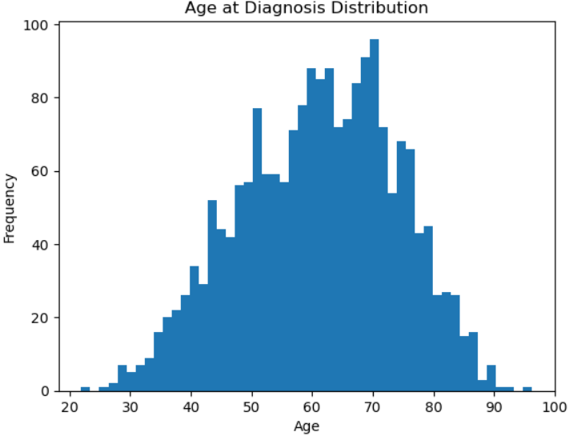
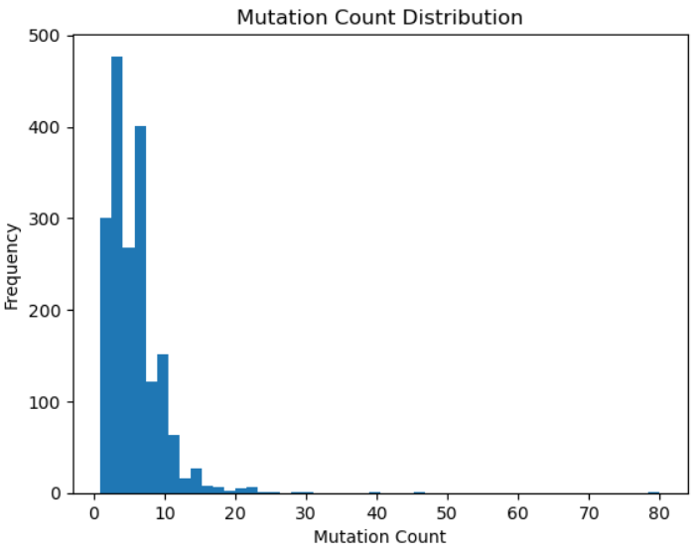
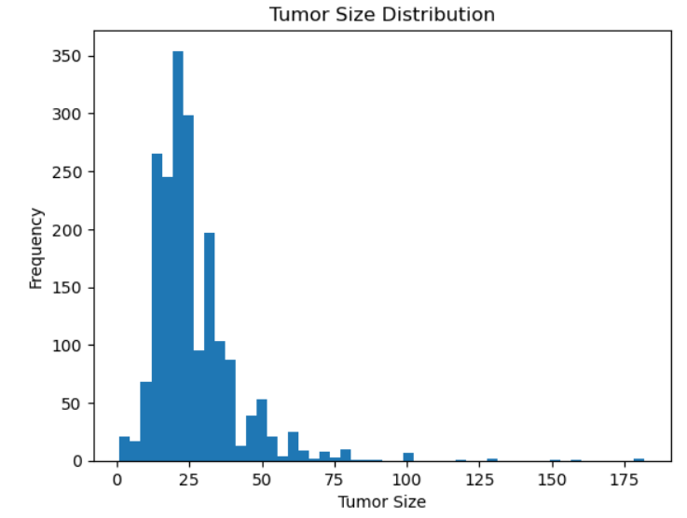
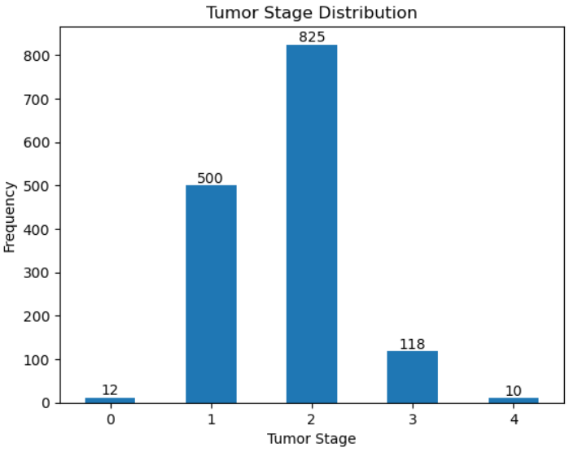
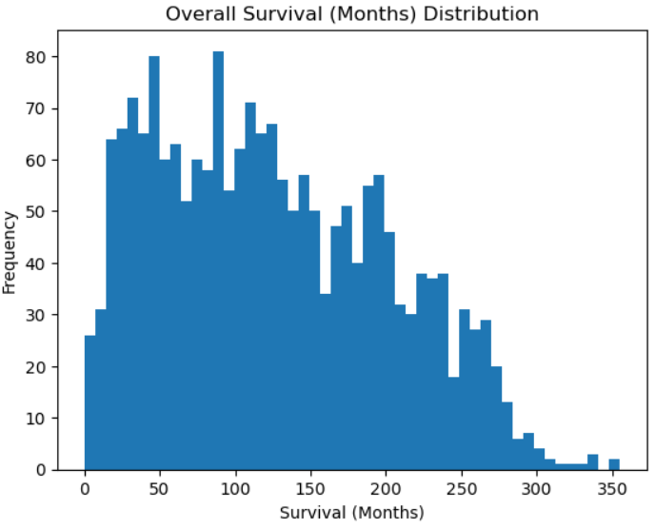
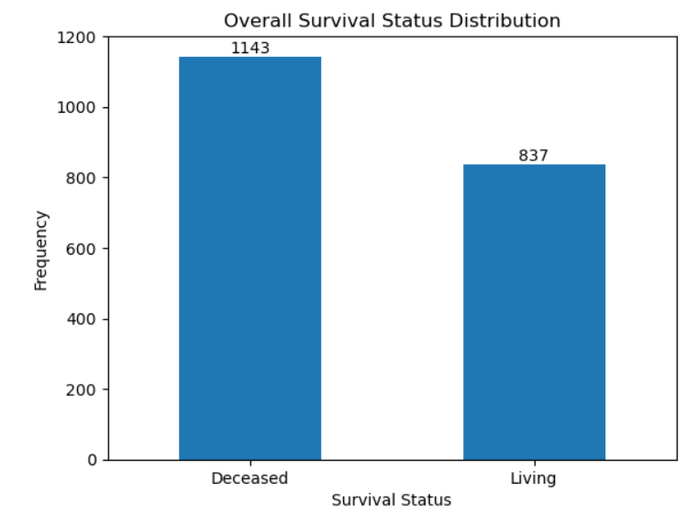
Exploratory Data Analysis

Slide 7
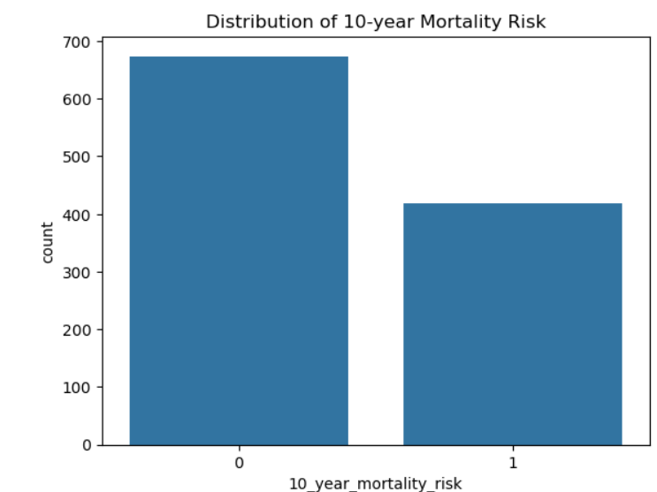
Target Variable
The target variable 10_year_mortality_risk is a binary classification that indicates whether an individual is at high or low risk of dying within 10 years.
It is created based on survival months and status from overall survival data.
This variable helps in predicting long-term survival outcomes and identifying key risk factors for mortality over a decade.
It is used to stratify patients and guide long-term management and treatment strategies.

Slide 8
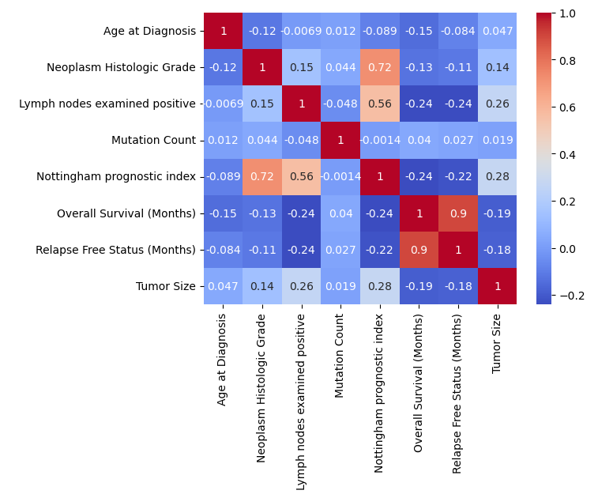
EDA – Corelation Matrix
Nottingham Prognostic Index has a strong positive correlation with Neoplasm Histologic Grade (0.72) and Lymph nodes examined positive (0.56), indicating a relationship between these variables.
Overall Survival is strongly positively correlated with Relapse-Free Status (0.9), as better relapse-free outcomes are usually associated with longer survival.
Tumor Size shows a moderate positive correlation with Lymph nodes examined positive (0.26) and Nottingham Prognostic Index (0.28), indicating larger tumors may lead to more lymph node involvement and worse prognosis.
The heatmap highlights that NPI, Lymph Node Involvement, and Tumor Size are strong predictors of prognosis in cancer patients. Relapse-free status is closely linked to overall survival, while mutation count and age have minimal impact on these clinical outcomes.

Slide 9
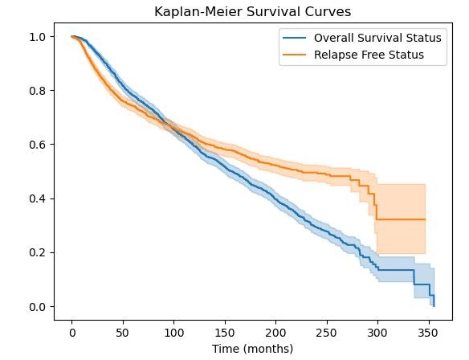
Survival Analysis
Kaplan Meier Survival Curves
The Kaplan-Meier survival plot shown compares the survival curves of two groups: Overall Survival Status (blue) and Relapse-Free Status (orange).
Overall Survival Status: This curve represents the probability of patients surviving over time (in months). The curve steadily declines, indicating that fewer patients survive from the start of the study. A more rapid decline suggests a higher mortality rate.
Relapse-Free Status: This curve represents the probability of patients remaining relapse-free over time. Initially, more patients remain relapse-free compared to overall survival, as shown by the orange curve. Over time, the relapse-free probability also decreases, but at a slower rate compared to overall survival. The orange shaded area is the confidence interval for this group.

Slide 10
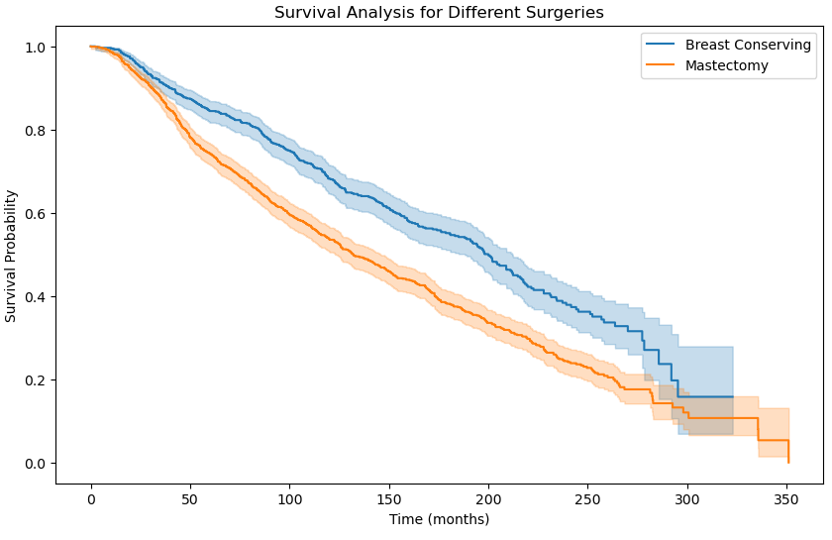
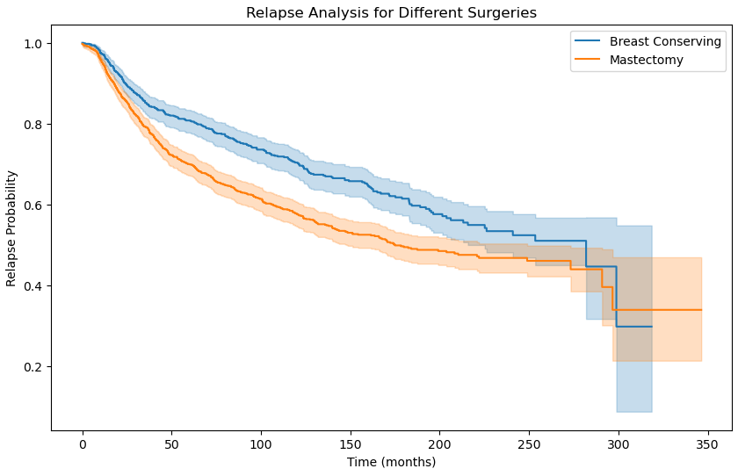
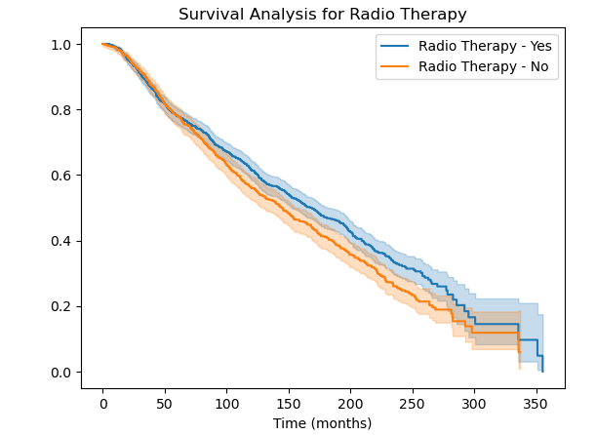
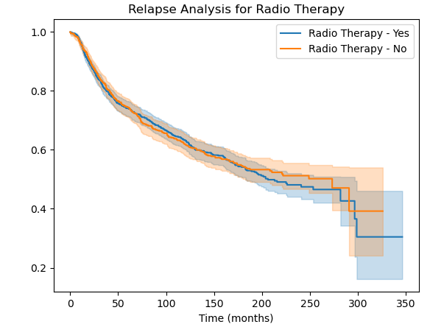
Kaplan Meier Survival Curves – in terms of Treatments

Slide 11
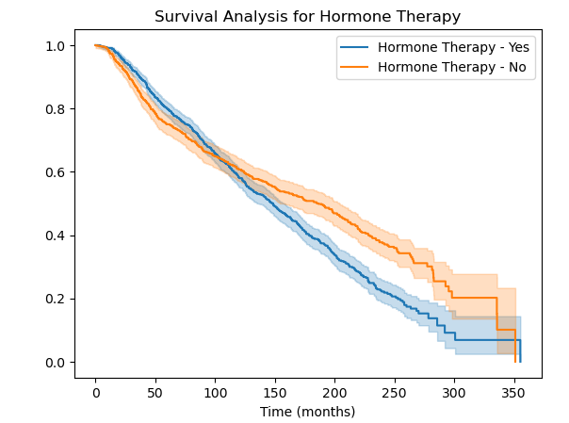
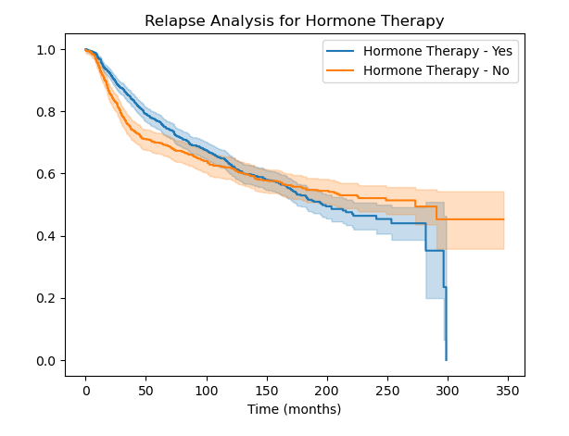
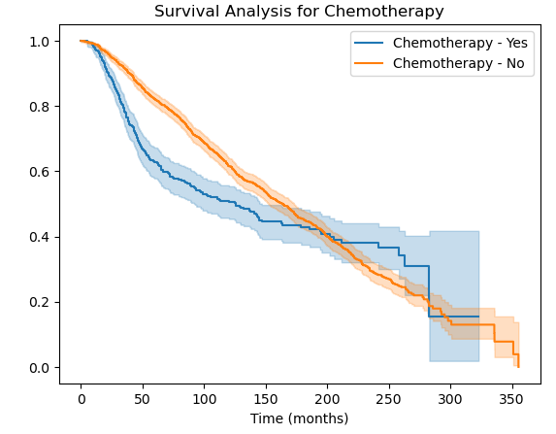
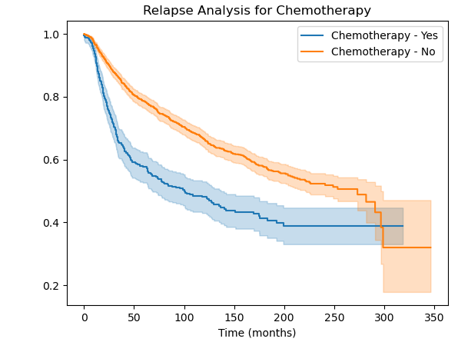
Kaplan Meier Survival Curves – in terms of Treatments

Slide 12
Model Selection
Logistic Regression: A statistical model used for binary classification tasks, which estimates the probability of an event by applying a logistic function. It predicts a categorical outcome (e.g., survival vs. non-survival) based on input features.
Support Vector Machine (SVM): A supervised learning algorithm that finds a hyperplane to best separate data into classes. It is effective in high-dimensional spaces and works well for both linear and non-linear classification tasks.
Decision Tree: A flowchart-like model used for classification and regression tasks. It splits data into subsets based on feature values, with each branch representing a decision and each leaf node representing a class label or output.

Slide 13
Key Findings
Metric | Logistic Regression | SVM | Decision Tree
Accuracy | 95% | 89.9% | 94%
Precision | 95% | 89% | 95%
Recall | 95% | 90% | 94%
F1-Score | 94% | 90% | 95%
ROC-AUC Score | 98.61% | 96.58% | 95.25%
Key Points
Logistic Regression: Highest overall performance across all metrics, with a 95% accuracy and 98.61% ROC-AUC score, indicating strong predictive ability and balance between true positives and false positives.
SVM: Slightly underperforms compared to the other two models, with 89.9% accuracy and a 96.58% ROC-AUC score. This suggests that while the model is decent, it might not generalize as well as Logistic Regression.
Decision Tree: Offers a good trade-off, with 94% accuracy and a 95.25% ROC-AUC score, making it a viable option with simpler interpretability compared to SVM.

Slide 14
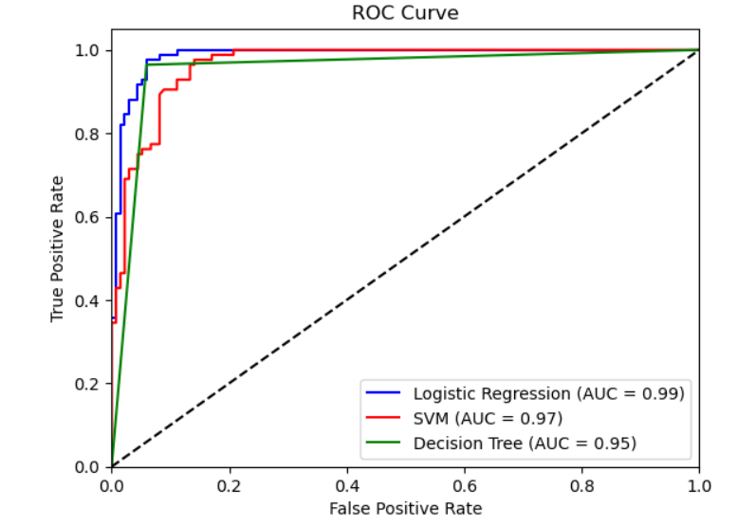
Inferences
True Positive Rate (TPR) vs. False Positive Rate (FPR):
The ROC curve plots the True Positive Rate (TPR) or sensitivity (y-axis) against the False Positive Rate (FPR) or 1-specificity (x-axis).
A model with perfect predictions would have a curve that reaches the top-left corner (TPR = 1 and FPR = 0).
Area Under the Curve (AUC):
Logistic Regression: AUC = 0.99 (excellent performance)
SVM: AUC = 0.97 (very good performance)
Decision Tree: AUC = 0.95 (good performance)
Model Comparison:
Logistic Regression performs the best with an AUC of 0.99, indicating that it has the best balance between sensitivity and specificity.
SVM comes close with an AUC of 0.97, indicating slightly lower performance than Logistic Regression but still highly effective.
Decision Tree has the lowest AUC at 0.95, though still a strong model, it performs slightly worse than the other two models.

Slide 15
Experimental Results
Logistic Regression is likely the best model for predicting the 10-year mortality risk based on this ROC curve since it maximizes the AUC.
SVM also performs well and may be a good candidate depending on other factors like interpretability or computational efficiency.
Decision Tree performs the least well in this comparison but might still be valuable due to its simplicity and ability to handle categorical features well.
In summary, Logistic Regression appears to be the most effective model based on the ROC curves and AUC values.

Slide 16
Thank You!

